Slide 1
SUB-STRUCTURE CONSTRUCTION
PART-B
BUILDING CONSTRUCTION AND PRACTICE

Slide 2
Box Jacking
Box jacking is a civil construction technique used for installing underground structures, such as tunnels, culverts, and underpasses, without disrupting surface activities. It involves pushing a prefabricated concrete box or segment through the soil using hydraulic jacks while simultaneously excavating the soil from the front.
Box jacking is also called tunnel jacking or jack box tunnelling.

Slide 3
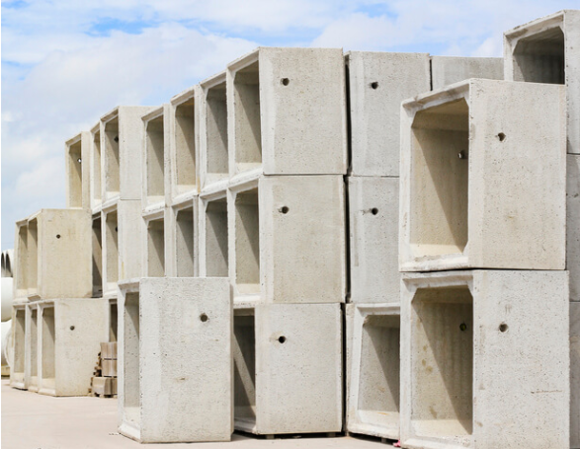

Slide 4
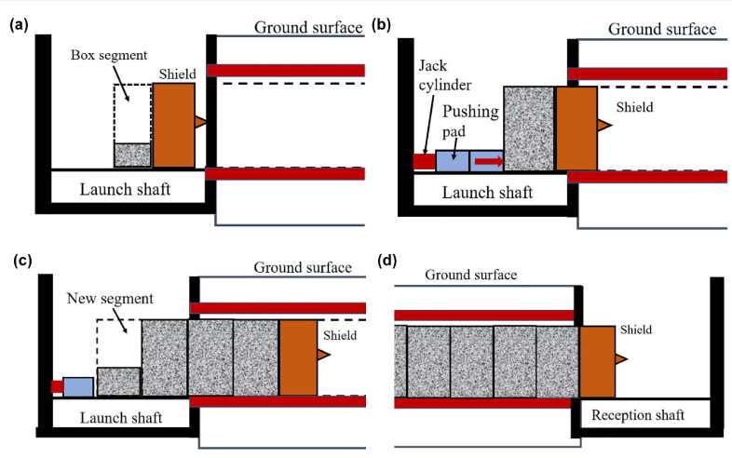

Slide 5
Benefits of Box Jacking
Minimal Surface Disruption: Ideal for railways, highways, or urban areas where excavation would cause significant disruption.
Faster Installation: Precast elements speed up the construction process.
Safer Execution: Reduces risks compared to traditional open-cut excavation.

Slide 6
Applications of Box Jacking
Highway and railway underpasses
Metro and pedestrian subways
Drainage culverts
Utility tunnels

Slide 7
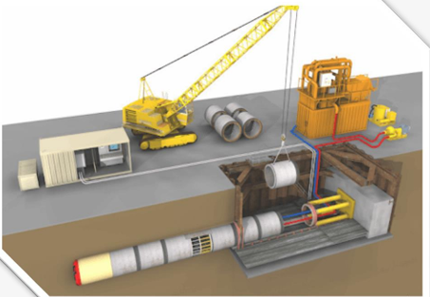
Pipe Jacking

Slide 8
Pipe jacking is a trenchless construction method used to install underground pipelines, conduits, or tunnels by pushing prefabricated pipe sections through the ground using hydraulic jacks. The process is commonly used for sewerage, drainage, and utility tunnels, reducing surface disruption compared to traditional excavation methods.

Slide 9
Process of Pipe Jacking
1. Site Preparation
A launch shaft (or jacking pit) and a receiving shaft are excavated at the starting and ending points.
Guide rails and thrust walls are set up to ensure accurate alignment of the pipes.
2. Installation of Hydraulic Jacks
Hydraulic jacks are placed in the jacking pit to push the pipe segments forward.
A cutting head or tunnel boring machine (TBM) is used in front of the first pipe to help excavate the soil.

Slide 10
3. Pipe Jacking Operation
The first pipe section is positioned in the jacking pit.
Hydraulic jacks push the pipe forward as soil is excavated ahead.
Additional pipe segments are added sequentially and jacked into place.
Spoil (excavated material) is removed using mechanical conveyors or pumping systems.
4. Completion and Finishing
Once all pipe sections are in place, the excavation at the receiving shaft is completed.
The hydraulic jacks are removed, and the pipe ends are sealed.
The shafts are backfilled, and the surface is restored.

Slide 11
Benefits of Pipe Jacking
1. Minimal Surface Disruption
Ideal for urban areas, highways, and railway crossings where open excavation is impractical.
2. Accurate Installation
Provides precise alignment, reducing the risk of misaligned pipes and leakage.
3. Safer Alternative
Eliminates the need for deep open trenches, reducing worker exposure to hazards.

Slide 12
4. Environmentally Friendly
Reduces the impact on existing infrastructure, landscapes, and ecosystems.
5. Suitable for Various Ground Conditions
Can be used in clay, sand, silt, and even hard rock with the right equipment.

Slide 13
Applications of Pipe Jacking
Sewer and Drainage Systems – Used for installing large-diameter sewer pipelines.
Water Supply Pipelines – Helps lay water transmission pipes with minimal disruption.
Railway and Highway Crossings – Allows utilities to be installed without disturbing traffic.
Oil and Gas Pipelines – Used for underground oil and gas transportation pipelines.
Utility Tunnels – Provides space for electrical, communication, and other utilities.

Slide 14
Disadvantages of Pipe Jacking
1. High Initial Cost
Requires specialized equipment and skilled labor, making it more expensive upfront compared to traditional methods.
2. Limited by Ground Conditions
Unstable or highly variable soils may cause difficulties and require additional support.

Slide 15
3. Length Constraints
Maximum jacking distances depend on soil conditions and pipe strength. Longer distances may require intermediate jacking stations.
4. Potential for Ground Settlement
Improper execution can lead to soil displacement, causing surface settlement or structural damage.
5. Requires Launch and Receiving Shafts
The construction of entry and exit shafts can be time-consuming and space-intensive.

